Slide 1
My Scheduling App
Developed by Cathy Hsu and Charles Knight

Slide 2
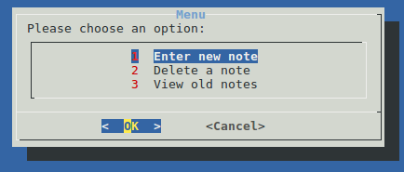
Project Description
A scheduling app designed for a user in a hurry! With our application, the user can:
Enter new reminders
Delete old reminders
View previous reminders
You’ll never have to worry about missing an appointment ever again!

Slide 3
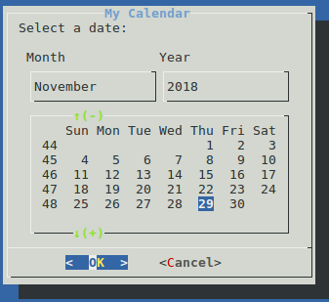
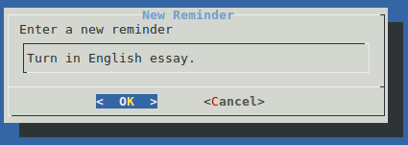
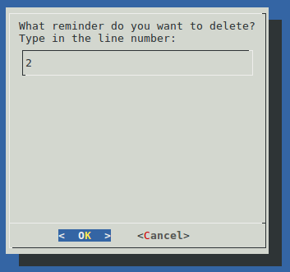
How do you use it?
Just select a date…
Enter a reminder
Delete a reminder

Slide 4
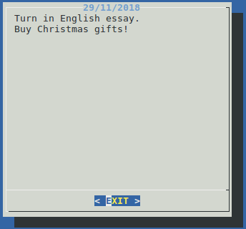
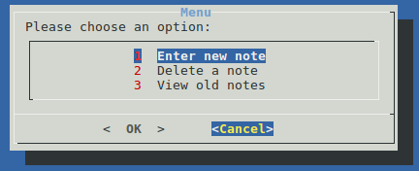
How do you use it?
View old notes
Exit the app by hitting ‘cancel!’

Slide 5
What did we learn?
Bash scripting:
Creating user interfaces
Redirection
Wildcards
Basic commands such as cut, grep, echo, rm
How to use VIM
Exiting

